Slide 1
The role of the National Agricultural Library in arthropod genomics research - implementing and developing tools for genomic data management
Monica Poelchau and the i5k Workspace@NAL team

Slide 2
Outline
What roadblocks are there for data management of genome sequencing projects?
What tools has the NAL developed to help overcome these roadblocks?
Why is the NAL uniquely positioned to help with ARS genomic data management?
What are our future plans?

Slide 3
Data management of genome sequencing projects.
How do you handle your data during research, and after research has been completed?
Scale.
High-throughput sequencing = vast amounts of sequence data.
The sheer scale creates a data management challenge:
Computational infrastructure;
Computational skills/basic UNIX literacy;
Basic domain knowledge in molecular biology and genomic data manipulation.

Slide 4
Data management of genome sequencing projects.
How do you handle your data during research, and after research has been completed?
Reusability.
Data re-use: genome sequencing projects often have the goal of being reference datasets, to be used across the scientific community¹.
Experience.
More and more, groups with little experience with genomic data are sequencing genomes and are encountering a steep learning curve.
¹ cf. National Research Council. A New Biology for the 21st Century. Washington, DC: The National Academies Press, 2009.

Slide 5
Genome project workflow
Initial planning
DNA/RNA sample generation
Genome sequencing and assembly - usually outsourced to sequencing center
Deposit raw reads and assembly at NCBI
Post-processing:
Annotation – ascribe function to elements of assembled dataset;
Quality assessment of assembly and annotations;
Manual curation of annotations;
Generate an ‘official gene set’ (OGS).
Host assembly and annotations in public DB for curation and public access.
Deposit OGS at NCBI.
Custom analyses.
Publish results in Nature.
Repeat.

Slide 6
The i5k Workspace@NAL
Our goal: to help any i5k genome with data management during the post-annotation process
We enable data access, visualization, and curation for any ‘orphan’ i5k species

Slide 7
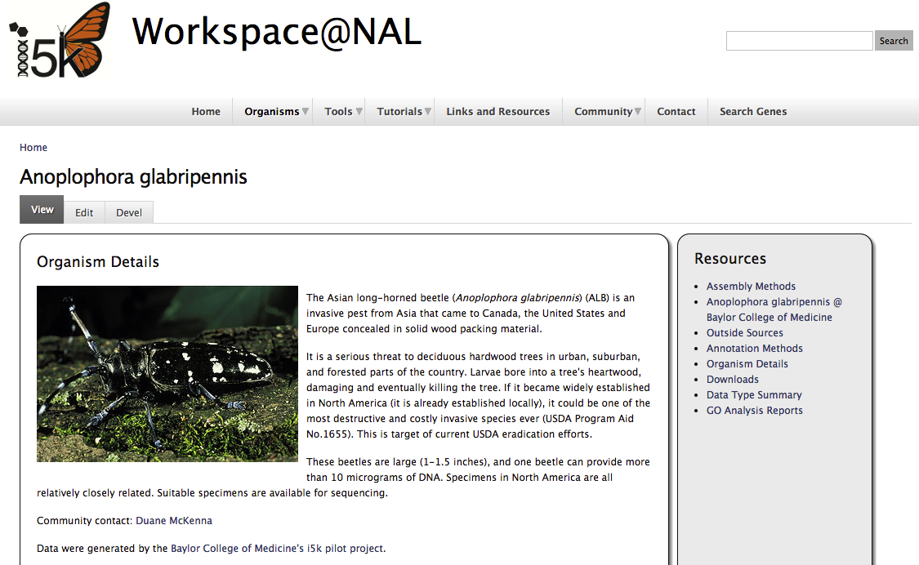
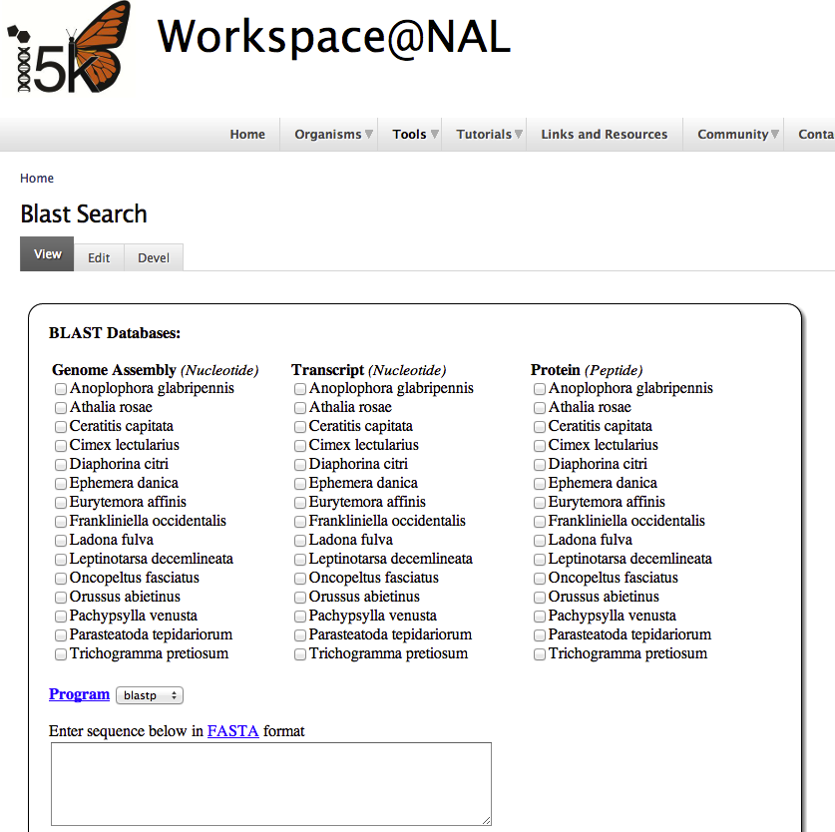
‘Frozen’ genome assembly
Automated annotations
Ancillary datafiles (e.g. RNA-Seq alignments)
Submission
Organism page
Web Apollo
Bulk downloads
Genome browser
Blast
Individual help and consultations
Official gene set v1.0
Tutorials
Tool development
https://i5k.nal.usda.gov/

Slide 8
I5k Workspace@NAL in numbers
33 species available – all with ‘pre-release’ annotations
230+ registered manual annotators
1/5 of annotators work on multiple species
>5,800 gene models manually curated

Slide 9
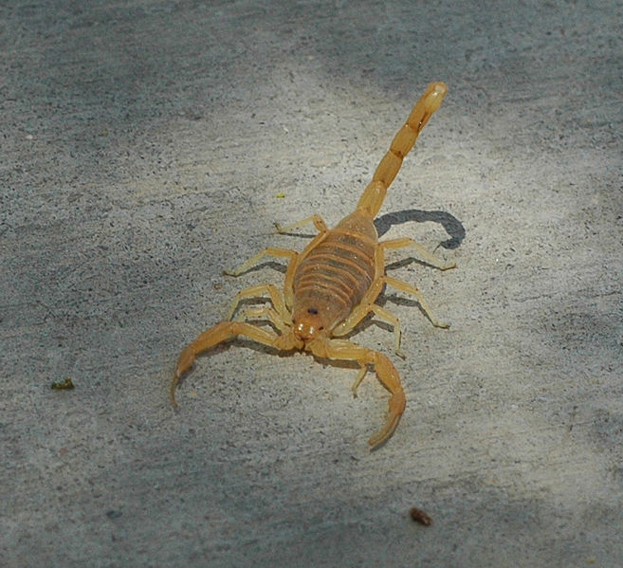
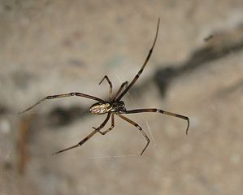
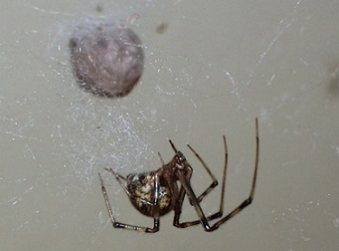
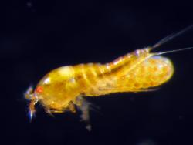
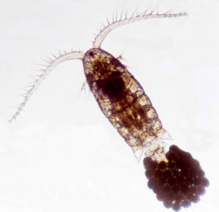
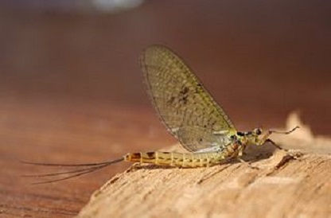
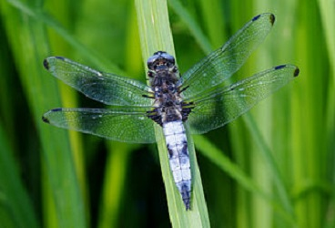
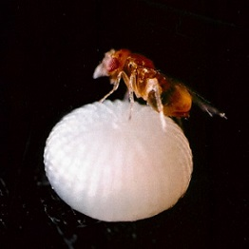
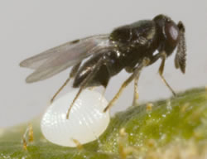
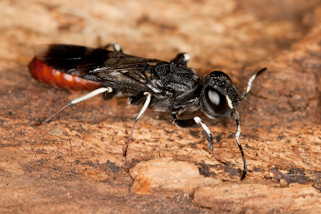
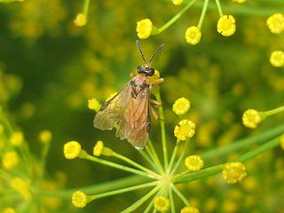
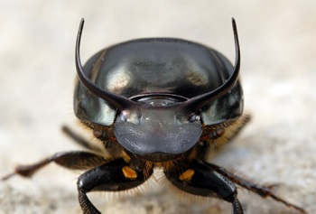
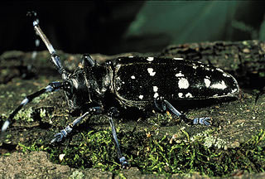
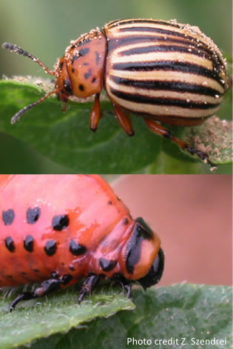
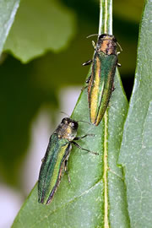
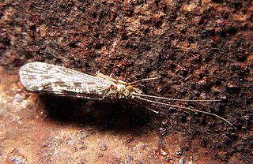
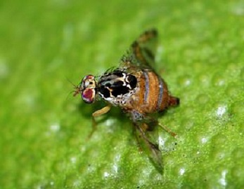
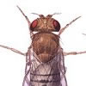
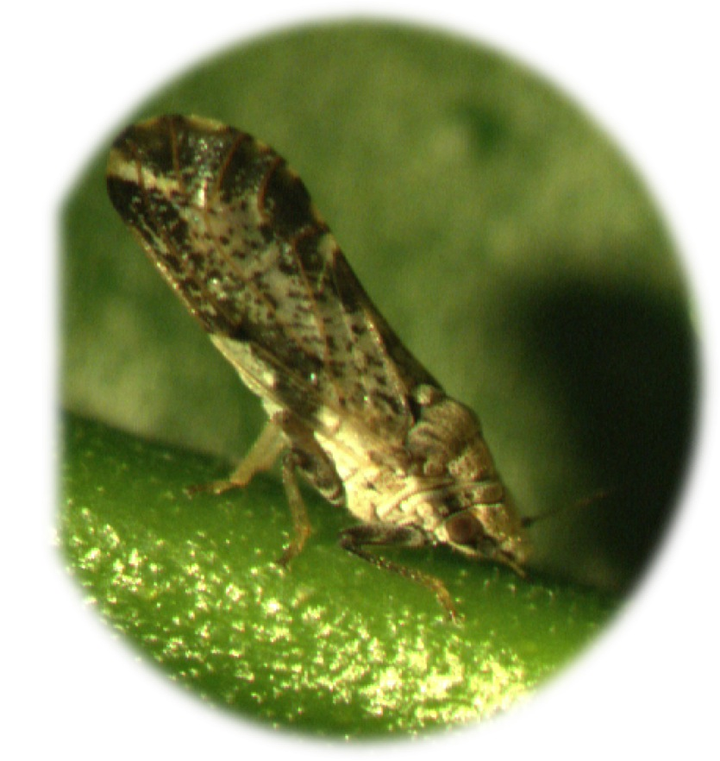
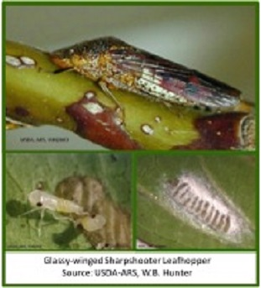
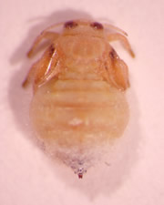
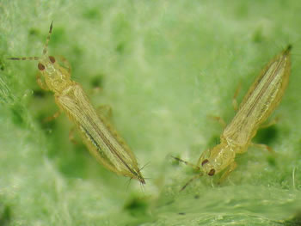
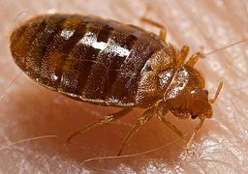
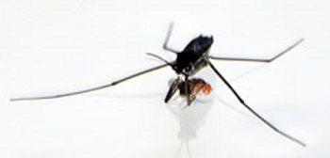
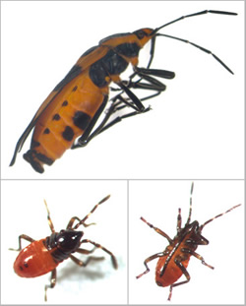
4 Arachnids
2 Copepods
2 Palaeoptera
4 Hymenoptera
4 Coleoptera
1 Trichoptera
9 Diptera
7 Hemiptera

Slide 10
Why the NAL?
Our mission. The NAL strives to collect, manage, disseminate, and preserve needed agricultural information for research scientists and the general public.
Permanence. NAL has the capability of operating beyond regular grant cycles.
Staff. Bioinformatics specialists, Information scientists, interns, web developers, IT staff, metadata librarian.

Slide 11
Genome project workflow
Initial planning
DNA/RNA sample generation
Genome sequencing and assembly - usually outsourced to sequencing center
Deposit raw reads and assembly at NCBI
Post-processing:
Annotation – ascribe function to elements of assembled dataset;
Quality assessment of assembly and annotations;
Manual curation of annotations;
Generate an ‘official gene set’ (OGS).
Host assembly and annotations in public DB for curation and public access.
Deposit OGS at NCBI.
Custom analyses.
Publish results in peer-reviewed journals.
Repeat.

Slide 12
A potential model for a future I5k Workspace
NCBI
Data archival
Quality assessment
Genome assembly
iPlant/ARS HPC
i5k Workspace @ NAL
Specialized analyses
I5k Workspace functions:
Visualize and access genomic data;
Easily access other i5k genomes;
Improve and update gene predictions dynamically;
Develop an ‘OGS’ for each community;
Quickly proceed to analyzing data;
Easier submission to NCBI.

Slide 13
The role of the NAL in AGR – we need your feedback!
Contact us! i5k@ars.usda.gov
Tell us your opinion in concurrent sessions 2a and 2b (Wednesday and Thursday).
View our web resources: https://i5k.nal.usda.gov/
Take our survey: www.surveymonkey.com/s/I5k_NAL_2014

Slide 14
Credits and acknowledgements
The NAL team:
Chris Childers
Vijaya Tsavatapalli
Gary Moore
Susan McCarthy
Chien-Yueh Lee, Han Lin, Jun-Wei Lin
I5k Workspace@NAL advisory committee:
Jay Evans
Don Gourley
Kevin Hackett
Simon Liu
Ursula Pieper
The i5k coordinating committee
The i5k pilot project (in particular Stephen Richards and Dan Hughes)
Wayne Hunter
iPlant
All of our users and data contributors!
CONTACT US: i5k@ars.usda.gov
https://i5k.nal.usda.gov/

