Slide 1
The i5k Workspace@NAL A Tripal based Arthropod genome portal
Christopher Childers
USDA/ARS/NAL
i5k.nal.usda.gov

Slide 2
Background
The i5k initiative tasked itself with coordinating the sequencing and assembly of 5000 insect or related arthropod genomes
The i5k Workspace@NAL is available to help any i5k project with genome hosting needs
Support community needs
Connect researchers to the data
Create standardized tools for accessing the data in useful ways
Provide resources to facilitate annotation projects

Slide 3
Key Components
Access
Portal built with Drupal/Tripal
Bulk data downloads
Query
BLAST/BLAT
Visualization and feature annotation
JBrowse/Web Apollo
Post-annotation support
Integrate annotations into an Official Gene Set (OGS)
Propagate the OGS across our resources

Slide 4
The i5k Workspace@NAL
Diverse representation across Arthropoda
39 species and counting
2 had OGS when they came to us, 1 is actively annotating
3 have completed an annotation phase and have OGS
25 are under active annotation
Facilitate collaboration between groups
Annotators work on related taxa
Domain specialists that focus on gene families across multiple species

Slide 8
Organism Pages

Slide 9
Organism Pages

Slide 11
Annotator Registration
Registration through a custom in-house module
All registrants are reviewed before approval
Permissions are at the organism level

Slide 12
Django BLAST
Redesigned: uses the latest version of BLAST+
Interface updates options based on inputs
Results persist for one week
HSPs are viewable in the genome browser
Code available on GitHub

Slide 13
BLAST Input

Slide 14
BLAST Results

Slide 15
JBrowse/Web Apollo

Slide 16
Right Out of the Box
Tripal functionality requiring no or minor changes
Drupal connection to Chado
APIs and functions
Bulk loading operations
Bulk deletion operations
Organism, analysis and dataset page creation
Bulk node creation, indexing

Slide 17
Customized Resources
Tripal integrated resources that were modified or bespoke
Registration module for Web Apollo
Completely built in house
Integrates notifications, account creation, and captcha
Modifications to the gene pages
Hierarchical view to display gene/transcript relationships
Accommodate sequence modification events
Annotation summary widget
Collects information for each instance
Multiple views to display the data in different contexts

Slide 18
Under Development
Widget tracks Web Apollo annotations
Real time updates for all of the annotated species
Tracks all annotation types Web Apollo supports
Front page
Organism page
Full table

Slide 19
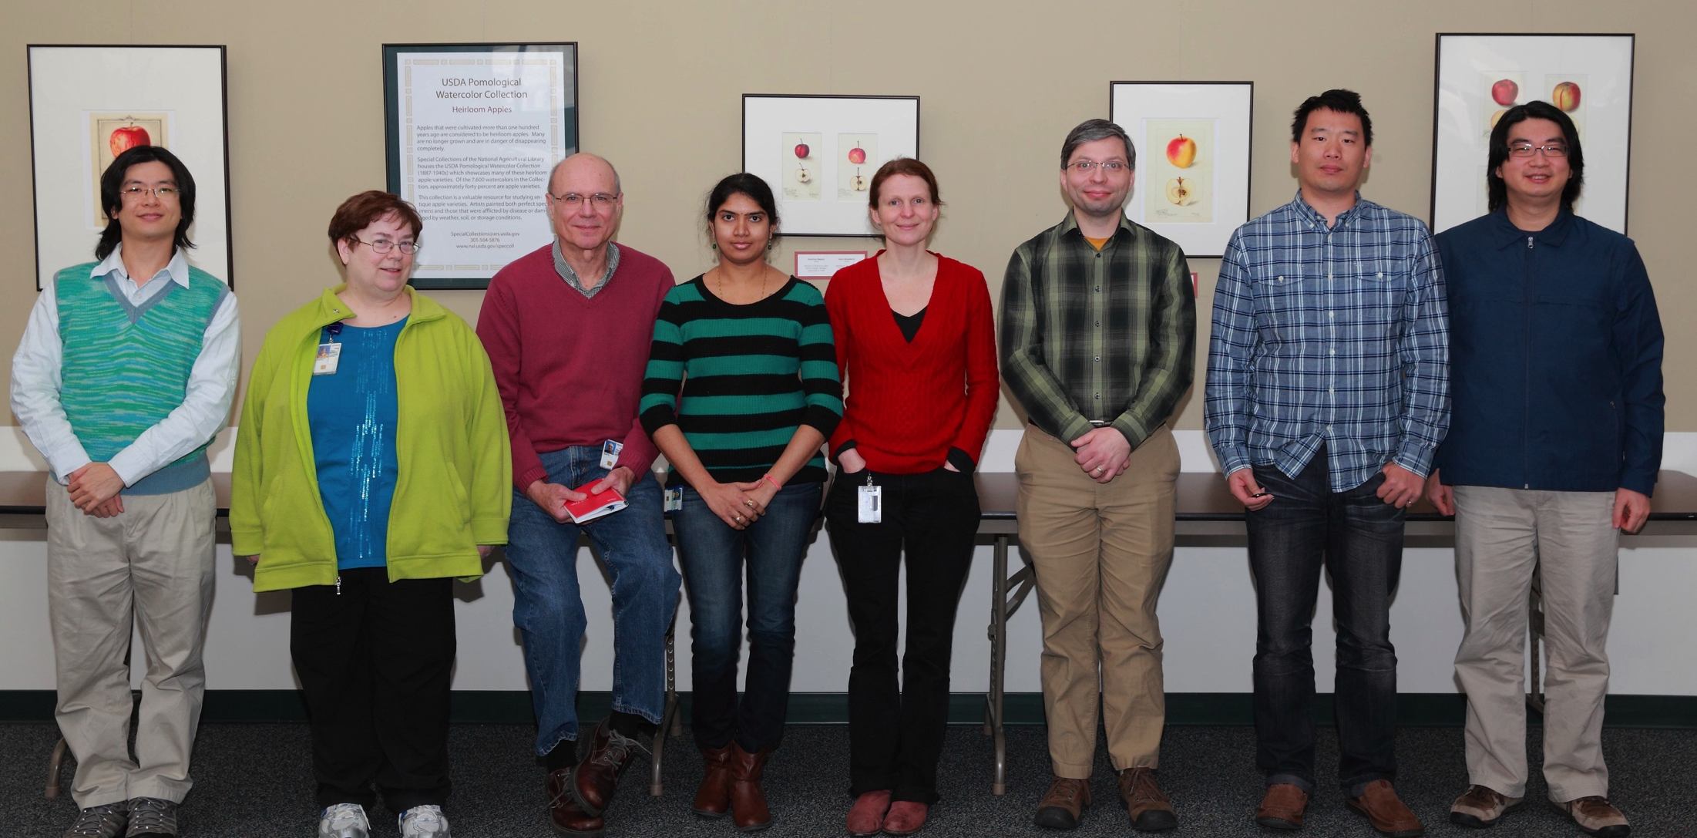
Acknowledgements
The NAL team
Monica Poelchau
Vijaya Tsavatapalli
Gary Moore
Susan McCarthy
Chien-Yueh Lee
Han Lin
Jun-Wei Lin
i5k Workspace@NAL advisory committee
Jay Evans
Don Gourley
Kevin Hackett
Simon Liu
Ursula Pieper
i5k coordinating committee
i5k pilot project
Wayne Hunter
All of our users and contributors!

Slide 20
For More Information
Visit us!
http://i5k.nal.usda.gov
Contact us!
i5k@ars.usda.gov
Learn about hosting a project with us
Become part of an existing project
Leave feedback or feature requests

