Slide 1
The i5k Workspace@NAL – enabling genomic data access, visualization and curation for the i5k community
Monica Poelchau and the i5k Workspace@NAL group

Slide 2
The i5k Workspace@NAL
Our goal: to help the i5k pilot project, and any other i5k genomes, during the post-annotation process
Reminder: We are all i5k! Any arthropod genome project is welcome.
NAL = National Agricultural Library
The i5k Workspace@NAL: a new collaboration between the i5k coordinating committee and the NAL to develop, improve and implement tools that allow better access to genomic information for ‘orphaned’ i5k genomes

Slide 3
CONTACT US: i5k@ars.usda.gov
I want the i5k Workspace@NAL to host my genome project.
I want to use the i5k Workspace@NAL to access i5k genomic data.
The i5k Workspace@NAL really needs to improve in X area for me to be willing to use it. I’ll let Monica know after the talk.

Slide 4
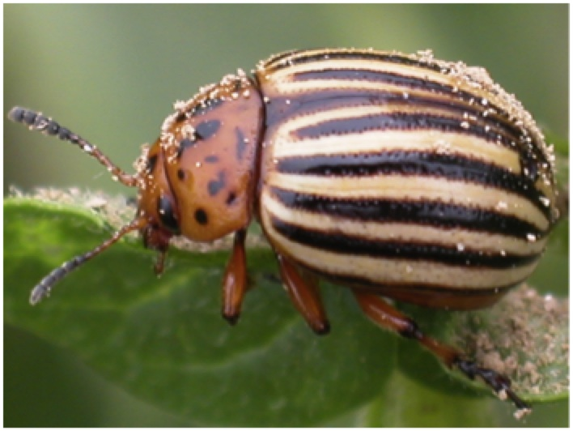
The life cycle of a ‘typical’ i5k genome project
Raw datafiles
Sequencing
Genome assembly
Genome annotation
DNA
RNA
Assembly
Annotations
Photo credit Z. Szendrei
How do you:
Share your data with collaborators;
Manually curate and improve your annotations;
Visualize your assembly and annotations;
Perform downstream analyses?
NCBI BioProject
i5k Workspace@NAL
iPlant
(http://www.iplantc.org/)

Slide 5
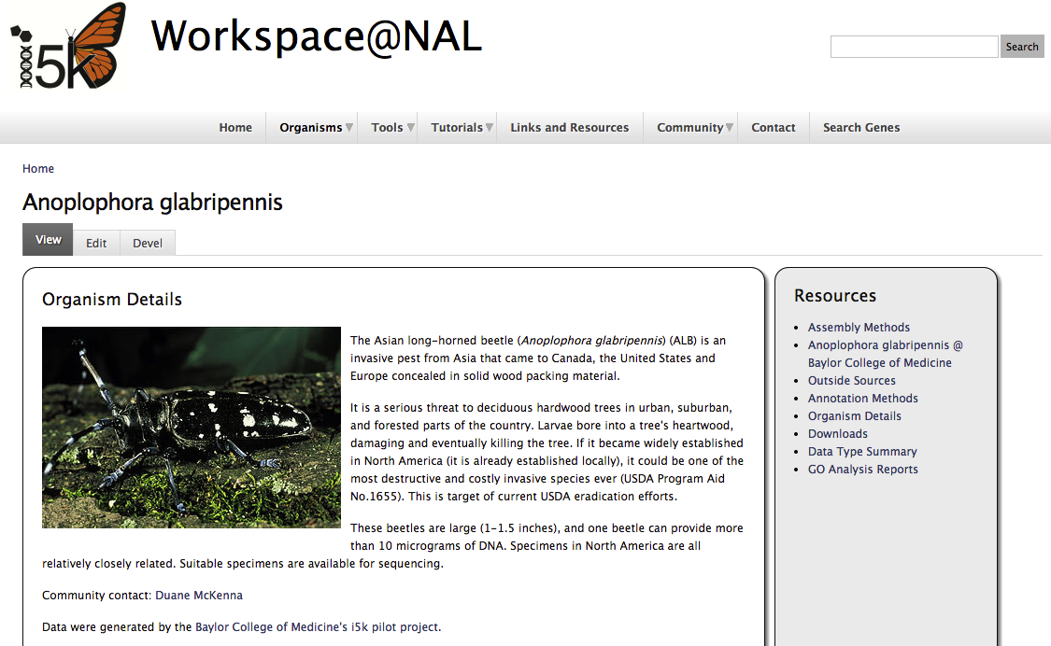
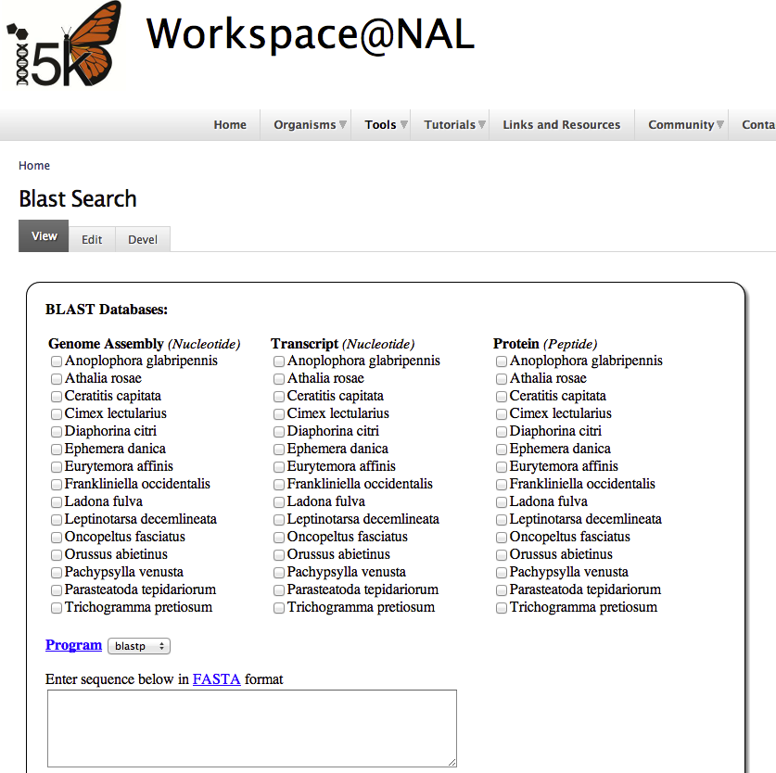
‘Frozen’ genome assembly
Organism page
Automated annotations
i5k Workspace @ NAL
Bulk downloads
Ancillary datafiles (e.g. RNA-Seq alignments)
Blast
Genome browser
Web Apollo
Integrated gene set v1.0
Tutorials
Individual help and consultations

Slide 6
I5k Workspace@NAL in numbers
>5,000 pageviews since April 10th, 2014
23 species available – all with ‘pre-release’ annotations
188+ registered annotators
>1,700 gene models annotated

Slide 7
Taxonomic scope
Arachnida: 1
Crustacea: 1
Palaeoptera: 2
Paraneoptera/Hemiptera: 6
Chrysomeloidea: 2
Hymenoptera: 3
Acalyptratae: 9

Slide 8
Example workflow

Slide 9
Example workflow

Slide 10
Example workflow

Slide 11
Example workflow

Slide 12
Example workflow

Slide 13
Some notes on manual gene model curation
Importance of gathering a community (see Monica Muñoz-Torres’ poster #48 on Saturday)
Collaborating with other taxonomic or interest groups to perform annotations of the same gene family across (more or less) closely related species
Helps to have RNA-Seq data, transcriptome alignments
Note that the quality of the automated annotations depend on the quality of the genome assembly – lower N50s will generally mean more work for the manual annotators

Slide 14
The life cycle of a ‘typical’ i5k genome project
Raw datafiles
Sequencing
Genome assembly
Genome annotation
DNA
RNA
Assembly
Annotations
Gene models
Photo credit Z. Szendrei
How do you:
Share your data with collaborators;
Manually curate and improve your annotations;
Visualize your assembly and annotations;
Perform downstream analyses.
iPlant
(http://www.iplantc.org/)

Slide 15
Performing downstream analyses
iPlant and CoGe have various comparative genomics tools
We are working with iPlant to integrate the i5k Workspace@NAL with iPlant’s datastore, which would allow immediate access to all of iPlant’s and CoGe’s analysis tools

Slide 16
Future plans and developments
Move Workspace to iPlant to allow direct analysis in the iPlant cloud
Metadata support (e.g. i5k-specific MIGS standards)
Improved data submission tools
Quality metric implementation and visualization
Ongoing tool improvement and development (including user suggestions)

Slide 17
Acknowledgements
The NAL team:
Chris Childers
Vijaya Tsavatapalli
Gary Moore
Susan McCarthy
Chien-Yueh Lee, Han Lin, Jun-Wei Lin
I5k Workspace@NAL advisory committee:
Jay Evans
Don Gourley
Kevin Hackett
Simon Liu
Ursula Pieper
The i5k coordinating committee
The i5k pilot project
Wayne Hunter
All of our users and data contributors!

Slide 18
CONTACT US: i5k@ars.usda.gov
We will have a site demo during TODAY’S poster session.
I want the i5k Workspace@NAL to host my genome project.
I want to use the i5k Workspace@NAL to access i5k genomic data.
The i5k Workspace@NAL really needs to improve in X area for me to be willing to use it. I’ll let Monica know after the talk.

